Slide 1
DASH Test framework Demo on Intel IPU
Reshma Sudarshan, Volodymyr Mytnyk

Slide 2
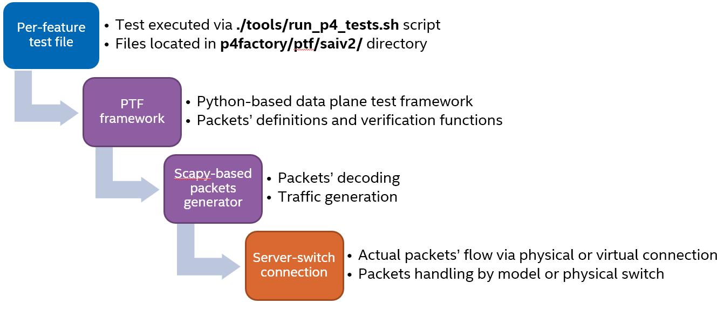
SAI PTF Test Harness for DASH
Auto-generated Python based dataplane testing framework
Thrift wrapper functions to call C-based SAI functions
Generated wrapper functions for SAI which can instead be generated based on SAI headers
DASH related enhancements:
Auto-generation framework and Underlay Test cases adopt to platforms with fewer ports
Auto-generation framework for DASH SAI APIs meta infrastructure
DASH and new Overlay test cases using this new framework

Slide 3
Demo Scenarios
Vnet to Vnet scenario using SAI thrift API.
ENCAP + routing outbound traffic flow example.
DECAP inbound traffic flow example.
Run scenarios using PTF framework.
Run Vnet inbound and outbound scenarios.
Stateless underlay ACL (DMAC) for network-to-host traffic.

Slide 4
SW Components and Traffic Flow

Slide 5
Inbound traffic flow support scenario
Configure inbound rules on IPU using auto-generated python SAI thrift client APIs.
Send VxLAN packet into network-to-host direction with VNET 2 header using PTF.
Check if packet matches ENI, otherwise dropped.
Check if packet matches outer SIP PA, otherwise dropped
Ensure that the packet matching inbound routing is DECAP.

Slide 6
Inbound scenario packet details

Slide 7
Scenario live demo

Slide 8
Outbound traffic flow support scenario
Configure outbound rules on MEV using auto-generated python SAI thrift client APIs.
Send IP (DECAP) packet to host-to-network direction with VNET 1 address using PTF.
Check if packet has been encapsulated according to CA-PA mapping routing table and correct VNET has been set in the VxLAN header.

Slide 9
Outbound scenario packet details

Slide 10
Scenario live demo

Slide 11
Thank you !

